Slide 1

SPEECH EMOTION RECOGNITION USING MACHINE LEARNING

Slide 2

AUTHORS : Dr. R.A.Khan
Jayesh Chaudhari Kalpesh Patil Ruturaj Savakare
Atharv Khamkar

Slide 3
PROBLEM STATEMENT
To accurately detect and categorized human emotions from user voice (on Hindi dataset), with the objective of enhancing applications in areas such as human-computer interaction, sentiment analysis, mental health assessment, and customer service.

Slide 4
MOTIVATION
By enabling computers to not only detect but also understand and respond to human emotions, we open up a world of possibilities across various domains, from healthcare, enhanced user Interaction, customer feedback analysis and education and special needs .

Slide 5
OBJECTIVES
Emotion Classification: Develop a machine learning model that accurately classifies human emotions conveyed in spoken language, including happy, angry, neutral, sad, and fear.
Real-Time Processing: Implement the system to perform emotion recognition in real-time, with minimal latency, enabling timely and meaningful responses.
Robustness: Create a model that can recognize emotions accurately even in the presence of background noise, varying recording conditions, and different accents.
Enhanced Human-Computer Interaction

Slide 6
LITERATURE REVIEW
Title | Author | Objective | Outcomes | Conclusion | Organization and Year
A Comprehensive Review of Speech Emotion Recognition Systems | Taiba Majid Wani, Mira Kartiwi, Eliathamby Ambikairajah | To explore and understand different Machine Learning and Deep Learning models for Speech Emotion Recognition. | Accuracy of 86.06% achieved using Convolutional Neural Network on Berlin Emotional Database. | After studying different models concluded that CNN is best suitable model for Speech Emotional Detection which give high accuracy | IEEE - 2021

Slide 7
LITERATURE REVIEW
Title | Author | Objective | Outcomes | Conclusion | Organization and Year
Deep Learning-Based Speech Emotion Recognition Using Multi-Level Fusion of Concurrent Features | SAMUEL KAKUBA 1,2, ALWIN POULOSE 3, AND DONG SEOG HAN | Deep learning-based model named concurrent spatial-temporal and grammatical (CoSTGA) model that concurrently learns spatial, temporal and semantic | To increase effectivness of model by concurrently learning all 3 features. jumps from 70% to 75%. | Results imply that concurrently learned spatial-temporal features with semantic tendencies learned in a multi-level approach improve the model’s effectiveness and Robustness. | IEEE - 2022

Slide 8
LITERATURE REVIEW
Title | Author | Objective | Outcomes | Conclusion | Organization and Year
IITKGP-SEHSC : Hindi Speech Corpus for Emotion Analysis | Shashidhar G. Koolagudi, Ramu Reddy, Jainath Yadav, K. Sreenivasa Rao | To use emotional speech database in Hindi to study the emotions embedded in speech signals for speech emotion recognition | The average emotion recognition rate is 71% | The average emotion recognition rate is 71%. Similar di- mensional emotions are misclassified as angry with happy & fear, sad with neutral | IEEE-2011

Slide 9
LITERATURE REVIEW
Title | Author | Objective | Outcomes | Conclusion | Organization and Year
Bangla Speech Emotion Recognition and Cross-Lingual Study Using Deep CNN and BLSTM Networks | SADIA SULTANA , M. ZAFAR IQBAL , M. REZA SELIM , MD. MIJANUR RASHID , AND M. SHAHIDUR RAHMAN. | To combine a d (DCNN) and a (BLSTM) network with a time-distributed flatten (TDF) layer over audio-only Bangla emotional speech corpus SUBESCO Database. Also evaluation with cross-lingual, and multilingual training-testing setups. | Given model works best with DCNN and A(BLSTM)for SUBESCO Dataset with accuracy 86.86%, and for a general English dataset “RAVDESS” is 82.7%. | Results reveal that the model with a TDF layer achieves better performance compared with other state-of-the-art CNN-based SER models. “SUBESCO” dataset can be applied for other languages as well with satisfactory performance . Also successful implementation on Bangla dataset. | IEEE - 2021

Slide 10
LITERATURE REVIEW
Title | Author | Objective | Outcomes | Conclusion | Organization and Year
Real-Time Speech Emotion Analysis for Smart Home Assistants | Rajdeep Chatterjee, Saptarshi Mazumdar, R. Simon Sherratt. | "Enhancing Smart Home Assistants to Recognize and Respond to Human Emotions in Real Time“. | MFCC features in Speech Emotion Recognition yielded remarkable results or accuracy of 95.79% (TESS Young) on standard emotion classification datasets | We conclude that the 1-D CNN classification models used in speaker-independent experiments are highly effective in the automatic prediction of emotion and are ideal for deployment in smart home assistants to detect emotion. | IEEE - 2021

Slide 11
LITERATURE REVIEW
Title | Author | Objective | Outcomes | Conclusion | Organization and Year
MNITJ-SEHSD: A Hindi Emotional Speech Database | Krishna Chauhan, Kamalesh Kumar Sharma, Tarun Varma | To create and tested on 3 models of cnn and comparing accuracy of dataset with existing hindi dataset. | Neutral and happy classes are better recognized compared to other classes, while sad is the least recognized emotion by listeners . MNITJ works better than previous dataset. | The average emotion recognition rate is 71% Also the third model gives 86% of acuracy which will be implemented in our system. | IEEE - 2023

Slide 12
MNITJ-SEHSD
Dataset :
Rich Emotional Data: MNITJ-SEHSD contains emotionally annotated Hindi speech recordings from ten speakers, covering happy, angry, neutral, sad, and fear emotions.
Supervised Annotation: Expertly labeled by MNIT Jaipur faculty, ensuring accurate emotional categorization for research purposes.
High-Quality Recording: Captured with precision using an omnidirectional microphone in a noise-free environment, providing clear recordings sampled at 16kHz.
Research Ready: With 500 utterances per emotion, MNITJ-SEHSD is a valuable resource for investigating emotional speech processing in Hindi.

Slide 13
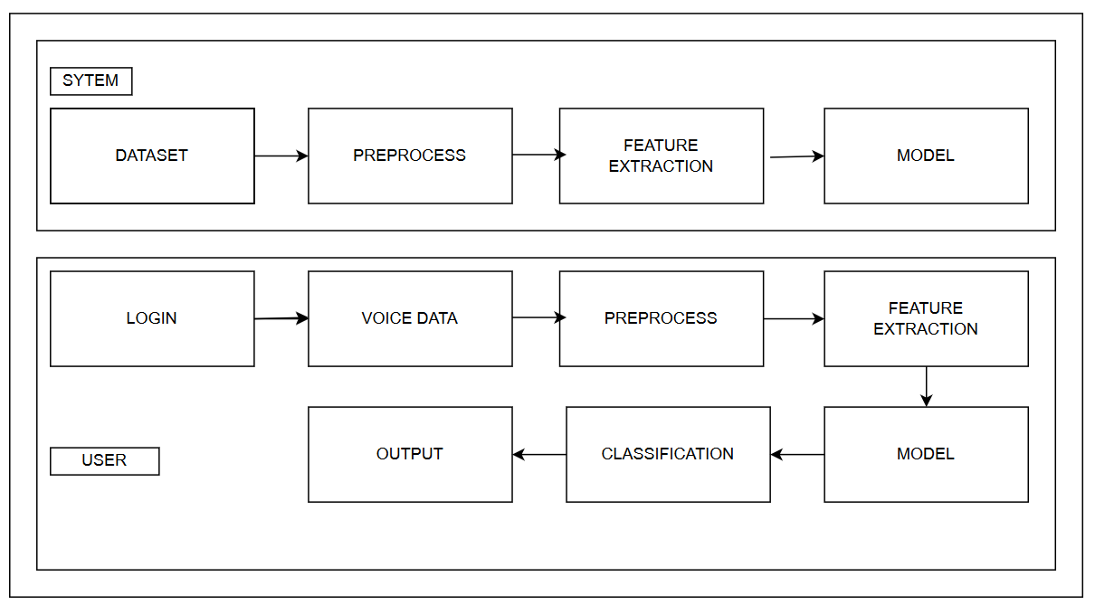
Our System

Slide 14
Data Collection and Preparation:
Obtain audio recordings from the MNITJ-SEHSD dataset, each labeled with emotion categories.
Use Python's os module to navigate the dataset and filter audio files with the ".wav" extension.
Utilize Librosa to load audio files and extract necessary information like waveform and sampling rate

Slide 15
Data Preprocessing
Data Augmentation
Normalize audio waveforms to a standard range for consistency.
Extract three types of features: MFCC, Chroma Features, and Mel Spectrogram using Librosa functions.
Aggregate these features by computing their mean across time frames to create fixed-dimensional feature vectors for each audio sample.

Slide 16
Data Augmentation
Benefits
Increased Dataset Size
Improved Model Generalization.
Reduced Overfitting.

Slide 17
Feature Engineering
Concatenate MFCCs, chroma features, and mel spectrograms to form comprehensive feature vectors representing acoustic properties.
Aim to capture both temporal and spectral characteristics relevant to emotion expression in speech

Slide 18
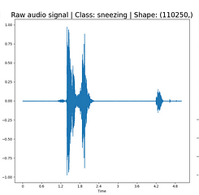
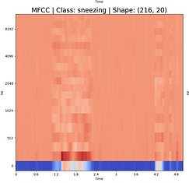
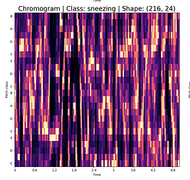
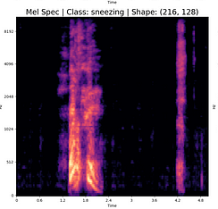
Feature Extraction
Wave to MFCC
Wave to chromagram
Wave to Mel Spectrogram

Slide 19
Model Architecture,
Training And Classification:
Design a CNN-based architecture for audio emotion recognition:
Conv1D layers for local feature extraction.
MaxPooling1D layers for down sampling.
Dense layers for high-level feature learning and classification.
Dropout for regularization.
Compile the model using Adam optimizer, sparse categorical cross-entropy loss, and learning rate schedule.
Partition dataset into training (80%) and testing (20%) sets.
Apply early stopping during training based on validation loss to prevent overfitting
Classify into five classes

Slide 20
CNN Layers
Layer Name | Layer Type | Filters | Output Size
Conv1D_1 | Conv1D | 32 | (input_shape[1], 32)
MaxPooling1D_1 | MaxPooling1D | - | (input_shape[1] // 2,32)
Conv1D_2 | Conv1D | 64 | (input_shape[1] // 2,64)
MaxPooling1D_2 | MaxPooling1D | - | (input_shape[1] //4, 64)
Conv1D_3 | Conv1D | 128 | (input_shape[1] //4, 128)
MaxPooling1D_3 | MaxPooling1D | - | (input_shape[1] // 8,128)
Flatten_1 | Flatten | - | (input_shape[1] // 8 * 128)
Dense_1 | Dense | 128 | 128
Dropout_1 | Dropout | - | 128

Slide 21
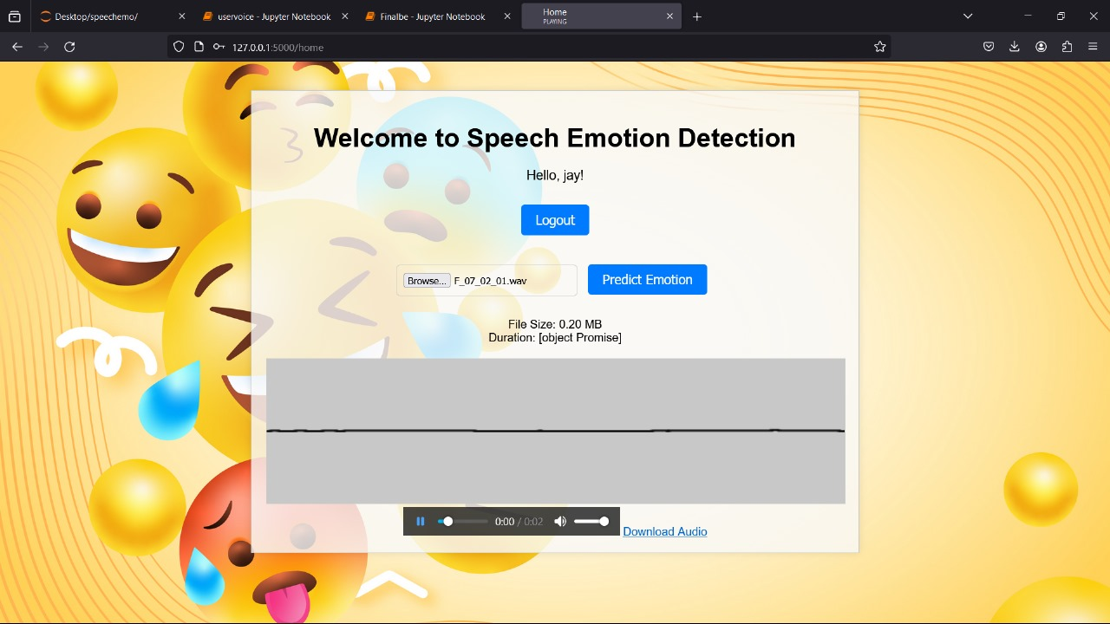

Slide 22
Future scope
Multimodal Integration: Combine audio, text, and physiological signals for comprehensive emotion recognition; explore fusion techniques for effective integration.
Real-time Applications: Develop real-time emotion recognition systems for immediate feedback; optimize lightweight models for low-latency inference.
Interdisciplinary Collaboration: Collaborate with experts in various fields to improve model performance and interpretability.
Ethical Considerations: Address privacy concerns and mitigate bias for equitable deployment.
Cross-Cultural Validation: Validate emotion recognition models across diverse cultural contexts; adapt models for cultural nuances in emotion expression

Slide 23
Result
Overall Accuracy: Achieved 91% accuracy across both training and testing datasets.
Generalization: Successfully generalized well to unseen data, showcasing the model's ability to recognize and categorize emotions accurately.
Validation: Validated the model's performance through rigorous testing on diverse datasets, ensuring its reliability.
Robustness: Demonstrated consistent improvement in accuracy over epochs, indicating the model's adaptability and robustness.

Slide 24
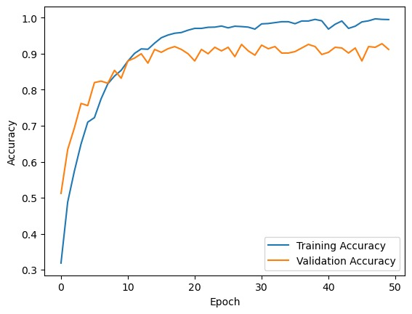
CONCLUSION
The CNN-based approach to audio emotion recognition shows promise for real-world deployment across various applications. By leveraging CNNs and feature extraction techniques like MFCCs and chroma, mel spectrograms, competitive accuracy rates are achieved on both training and testing datasets .The CNN architecture offers a robust framework for emotion recognition.
Test Accuracy: 0.9108911156654358
Precision: 0.9126094298196452
Accuracy for Each Class:
Neutral: 0.91
Angry: 0.9607843137254902
Happy: 0.8469387755102041
Fear: 0.9574468085106383
Sad: 0.8828828828828829

Slide 25
REFERENCES
[1]S. Sultana, M. Z. Iqbal, M. R. Selim, M. M. Rashid and M. S. Rahman, "Bangla Speech Emotion Recognition and Cross-Lingual Study Using Deep CNN and BLSTM Networks," in IEEE Access, vol. 10, pp. 564-578, 2022, doi: 10.1109/ACCESS.2021.3136251.
[2]S. Kakuba, A. Poulose and D. S. Han, "Deep Learning-Based Speech Emotion Recognition Using Multi-Level Fusion of Concurrent Features," in IEEE Access, vol. 10, pp. 125538-125551, 2022, doi: 10.1109/ACCESS.2022.3225684
[3] T. M. Wani, T. S. Gunawan, S. A. A. Qadri, M. Kartiwi and E. Ambikairajah, "A Comprehensive Review of Speech Emotion Recognition Systems," in IEEE Access
[4] A Framework for Hate Speech Detection Using Deep Convolutional Neural Network.by PRADEEP KUMAR ROY 1,3 , ASIS KUMAR TRIPATHY 1 , (Member, IEEE), TAPAN KUMAR DAS 1 , (Member, IEEE), AND XIAO-ZHI GAO 2. In IEEE 2020.
[5]Chatterjee, Rajdeep & Mazumdar, Saptarshi & Sherratt, Robert & Halder, Rohit & Maitra, Tanmoy & Giri, Debasis. (2021). Real Time Speech Emotion Analysis for Smart Home Assistants. IEEE Transactions on Consumer Electronics. PP. 1-1. 10.1109/TCE.2021.3056421.

Slide 26
REFERENCES
[6] Krishna Chauhan, Kamalesh Kumar Sharma, Tarun Varma, "MNITJ-SEHSD: A Hindi Emotional Speech Database". " DOI : 10.1109/IC3S57698.2023.10169497 in IEEE Access
[7] Shashidhar G. Koolagudi, Ramu Reddy, Jainath Yadav, K. Sreenivasa Rao, "IITKGP-SEHSC : Hindi speech corpus for emotion analysis" in IEEE Access, doi: 10.1109/ICDECOM.2011.5738540

Slide 27

THANK YOU

